Slide 1
RATING PREDICTION PROJECT
Submitted By:
Milind B. Kuwar

Slide 2
Problem Statement
Sentiment Analysis is the task of analyzing people’s opinions in textual data (e.g., product reviews, movie reviews, or tweets), and extracting their polarity and viewpoint. The task can be cast as either a binary or a multi-class problem. Binary sentiment analysis classifies texts into positive and negative classes, while multi-class sentiment analysis classifies texts into fine-grained labels or multi-level intensities.
The prediction for rating for a particular review on any e-commerce site can help their listers/makers of those products to find the problems or positives that a customer is facing after buying this product. This can help these e-commerce sites to grow or retain their businesses. Here, we have built a ML model that processes Review posted on Amazon using common NLP techniques. This task is similar to Sentiment Analysis, but instead of predicting the positive and negative sentiment (sometimes neutral also), here I need to predict the star rating

Slide 3
Dataset Exploration
Project contain train and test dataset.
In data set there are 29,535 rows and columns.
There are no null values in the dataset
Comments is object in nature and consist of text.
Overall memory usage for train and test is around 15MB.

Slide 4
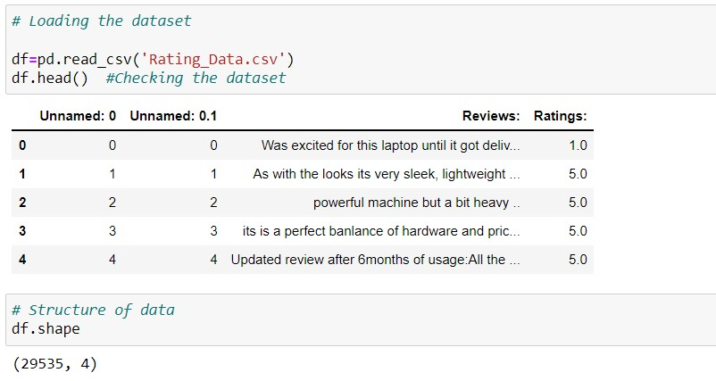
Exploratory Data Analysis

Slide 5
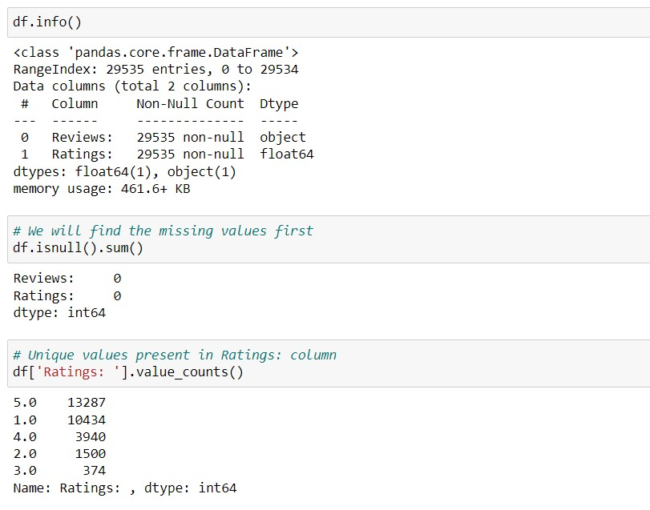
Then we further checked more about data using info, checked datatypes using dtypes, shapes using .shape, columns using .columns, null values using .isnull.sum and further visualize it through heatmap as follows:

Slide 6
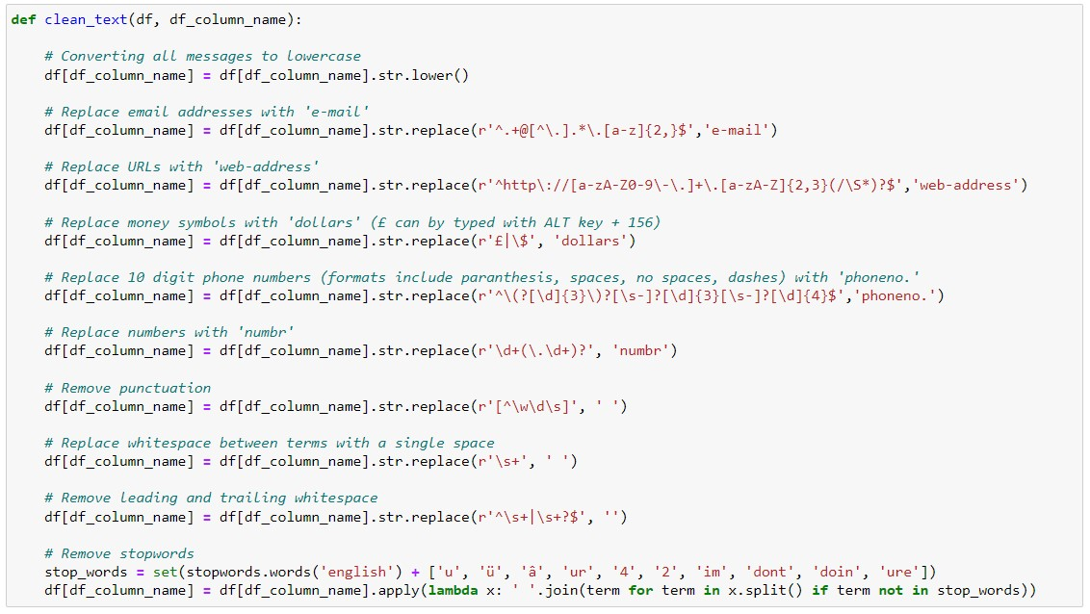
Data Preprocessing
As there are no null values in the dataset, but as the comment column in text format hence it requires pre processing.

Slide 7
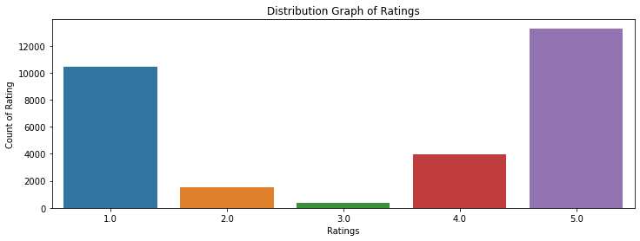
Data Visualization

Slide 8
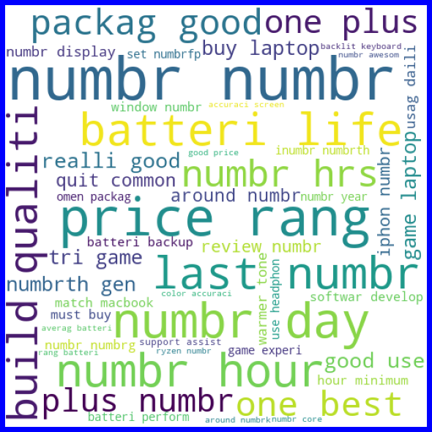
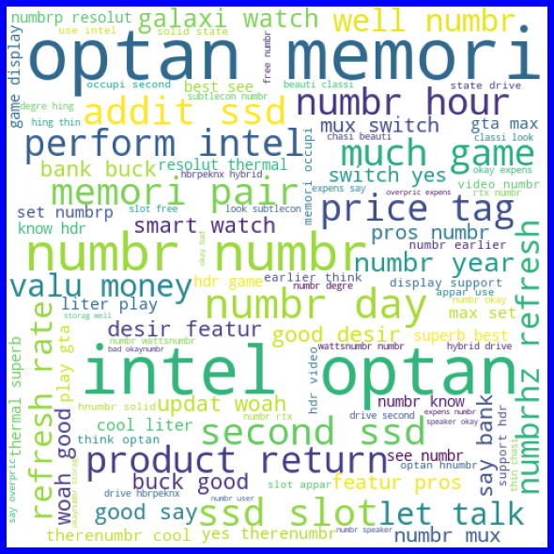

Slide 9
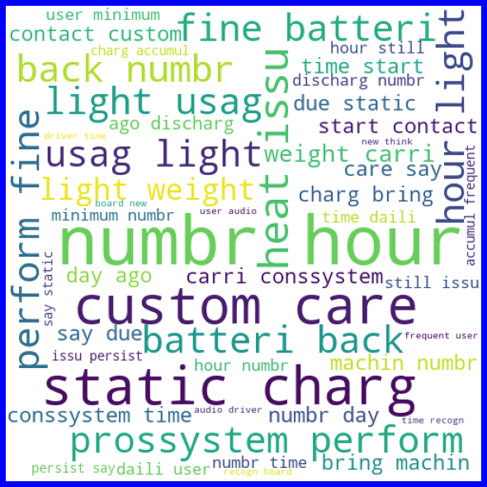


Slide 10


Slide 11
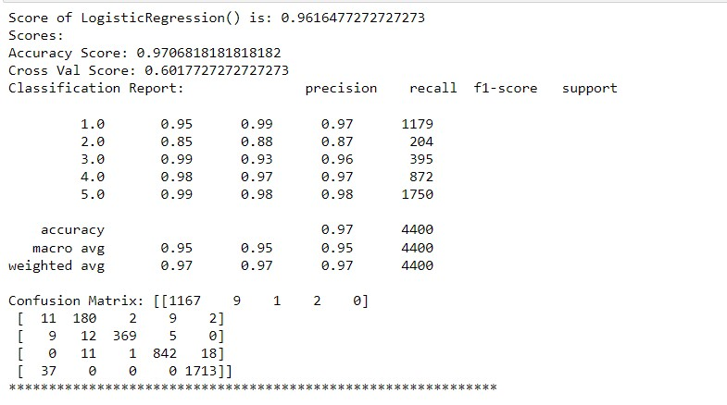
Model Training
Logistic Regression

Slide 12
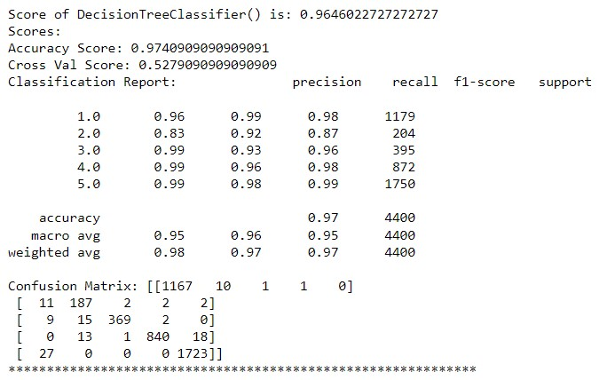
Decision Tree Classifier

Slide 13
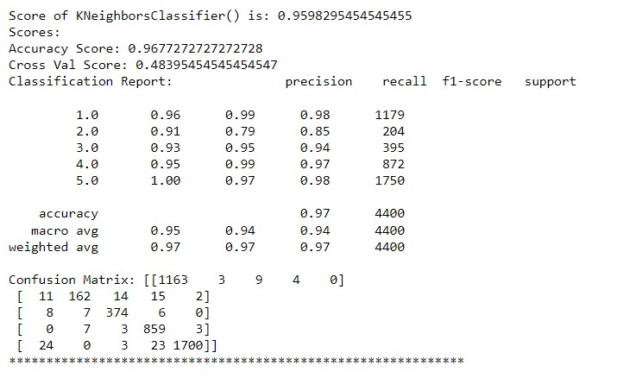
Kneighbours Classifier

Slide 14
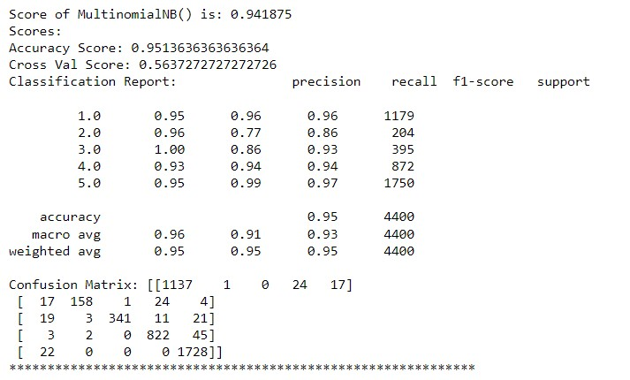
MultinominalNB

Slide 15
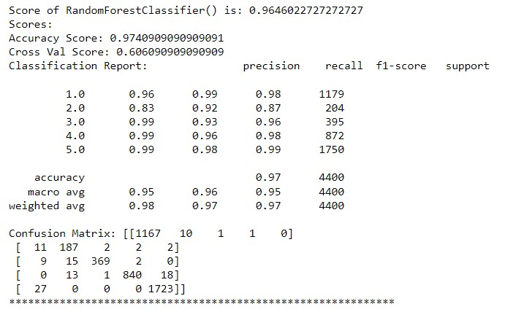
Random Forest Classifier

Slide 16
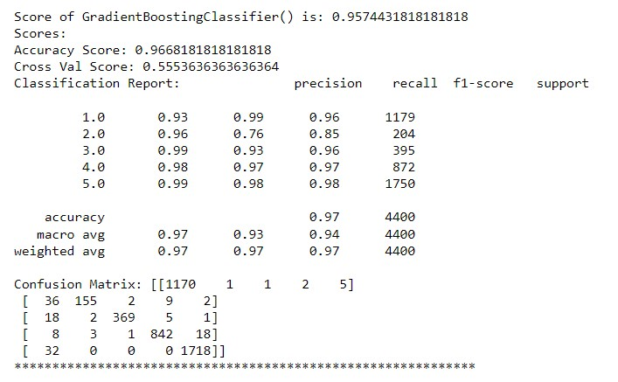
Gradient Boosting Classifier

Slide 17
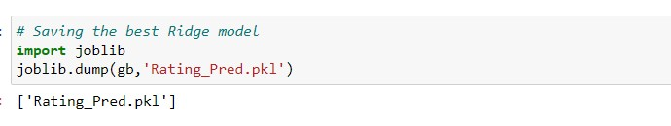
Saving The Model

Slide 18
Conclusion
After using different models for classification, we concluded that Random Forest Classifier was best suited to train the dataset for Rating Prediction Analysis. - The dataset was imbalanced in nature. - Some data had to be omitted from the datasets in order to remove data irrelevant to the dataset.
As the datasets was huge it created problems when we tried to manipulate it or cleanse it. As when we tried to cleanse it we had to take care that data doesn’t loose its relevancyand structure. So, we tried to remove much of the unnecessary data from the datasets that was in our reach during the given time. - And finally, we came to know that the best algorithm used to train the machine.
For this the dataset is Random Forest Classifier as all the values along the metrics were highest.

